Slide 1
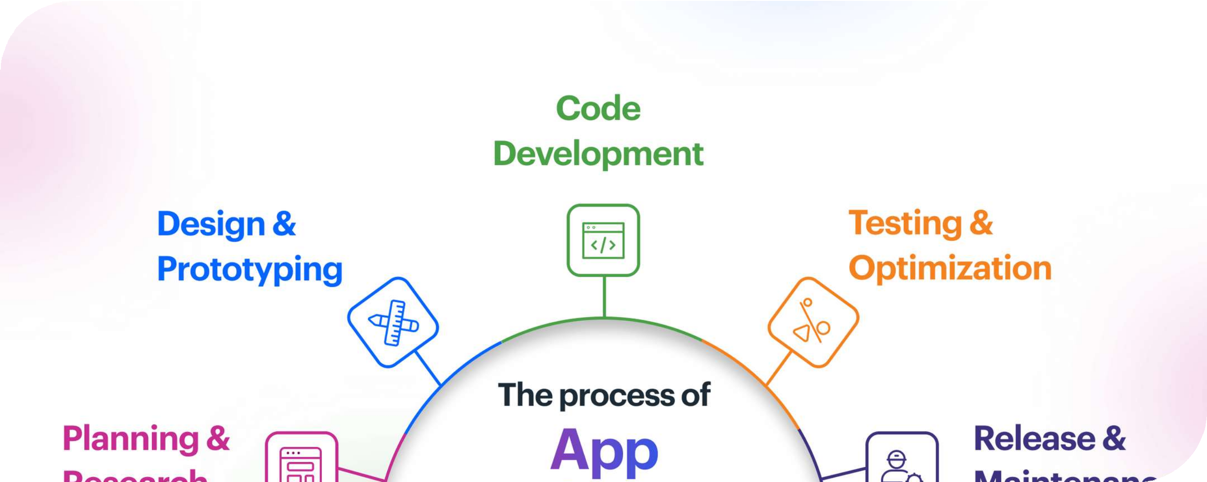
Application Development
Group 4 : Nguyen Huy Hoang, Tran Van Duy, Nguyen Tuan Anh

Slide 2

Table of Content
Overview
Stakeholders
The difficulties that BudgetWise Solutions might encounter
The issues that need to be addressed Business application solutions
Areas of risk pertaining to this software project and explore strategies for managing these risks

Slide 3
Project Overview
Develop an intuitive mobile application, CampusExpense Manager, to help university students manage their expenses effectively and stay within their budgets.
Functional Requirement
User Registration and Authentication Expense Tracking
Budget Setting. Expense Overview. Recurring Expenses. Expense Reports Expense Notifications
Non-Functional Requirement
Performance.
User-Friendly Interface.
List an accomplished objective. Platform Compatibility.
Data Security Monetization (Optional)

Slide 4



Stakeholders
Student
BudgetWise solution team University management

Slide 5
Requirement
User registration and authentication
The account creation and login process is secure Expense TrackingAdd, edit and categorize expenses
Set a budgetSet monthly budgets for various categories Cost overview
Summary of monthly expenses and budget situation Recurring expenses
Manage recurring expenses with start and end dates Expense report
Generate detailed reports over time
Cost notifications: Reminders when budget limits are about to be reached or exceeded

Slide 6
Stakeholder requirements
Student:
Track expenses visually
Set and adjust budgets easily Detailed expense reports Reliable notifications
BudgetWise solution group:
Successful application development within time and budget Full resource management and skills development
University management board:
Promote financial management among students Support responsible financial behavior

Slide 7

Potential Difficulties Overview
Challenges
Limited development experience
Strict timeline and budget Ensuring data privacy

Slide 8
Limited Development Experience
Introduction | Impact
Junior Team: The development team mainly consists of junior developers with limited expertise. | Poor Performance: The application may face performance issues and software bugs due to a lack of experience in optimizing the code.
 | Longer Development Time: Inexperience can lead to prolonged development as the team encounters and solves unforeseen problems.

Slide 9
Development Timeline Constraints
Timeline:
Strict Timeline: The project has a rigid 12-week timeline from concept to launch. Adhering to this tight schedule can be challenging, especially given the team's limited experience.
Training Needs: Junior developers will need training and skill development throughout the project. This additional time requirement could strain the already tight schedule.
.

Slide 10
Budget Constraints
Budget:
Limited Funds: The project has a constrained budget for both development and marketing. Managing resources effectively is crucial to avoid budget overruns.
Additional Costs: Ensuring data privacy and platform compatibility may incur extra expenses that need to be accounted for in the budget.

Slide 11
Data Privacy Compliance
Regulations:
Compliance Requirements: The app must adhere to stringent data privacy regulations to ensure the security and confidentiality of user data.
Complexity: Implementing robust data protection measures can be technically complex and time-consuming.

Slide 12
Others
Offline Capability
Functionality: The app must operate effectively without an internet connection to cater to students in areas with limited connectivity.
Data Syncing: Efficiently syncing data when connectivity is restored, without causing data loss or duplication.
Platform Compatibility
Platforms:
Multiple Platforms: The app needs to be developed for Android platforms to reach a broader user base.
Development Effort: Ensuring compatibility across different platforms requires additional development and testing effort.

Slide 13
Highlighting and describing the issues that need to be addressed in the given scenario:
User Registration and Authentication
Issues:
User Account Creation: Ensuring users can easily create accounts with a username and password.
Secure Authentication: Implementing secure authentication methods to protect user data and ensure only authorized access.
Solutions:
Account Creation: Implement a simple and intuitive registration form with validation.
Secure Authentication: Use industry- standard authentication mechanisms, such as OAuth or JWT, and incorporate two- factor authentication for added security.
Expense Tracking
Issues:
Adding and Editing Expenses: Allowing users to efficiently add, edit, and categorize their expenses.
Detailed Expense Entries: Ensuring each expense entry includes a description, date, amount, and category.
Solutions:
User Interface: Design a user-friendly interface for adding and editing expenses with dropdown menus for categories.
Data Entry Validation: Implement validation to ensure all required fields are filled out correctly.

Slide 14
Highlighting and describing the issues that need to be addressed in the given scenario:
Budget Setting
Issues:
Setting Monthly Budgets: Enabling users to set and adjust monthly budgets for different expense categories.
Flexibility: Allowing users to adjust budget amounts as needed.
Solutions:
Budget Interface: Provide a simple interface for setting and adjusting budgets.
Notifications: Include notifications to alert users when they adjust their budgets.
Expense Overview
Issues:
Summary of Expenses: Providing a comprehensive summary of monthly expenses.
Expense Trends: Allowing users to view expense trends over time.
Solutions:
Dashboard: Create a dashboard that summarizes total spending, remaining budget, and a breakdown by category. Graphs and Charts: Use visual aids like graphs and charts to display expense trends.

Slide 15
Highlighting and describing the issues that need to be addressed in the given scenario:
Recurring Expenses
Issues:
Adding Recurring Expenses: Allowing users to add recurring expenses with start and end dates.
Automatic Inclusion: Ensuring recurring expenses are automatically added to the user's monthly budget.
Solutions:
Recurring Expense Feature: Implement a feature to add recurring expenses with flexible start and end dates.
Automatic Updates: Ensure the app automatically includes these expenses in the monthly budget.
Expense Reports
Issues:
Generating Reports: Allowing users to generate detailed expense reports for specific time periods.
Category Breakdown: Including a breakdown of expenses by category in the reports.
Solutions:
Report Generation: Implement a feature to generate detailed reports for monthly, quarterly, or annual periods.
Detailed Breakdown: Ensure reports include a clear breakdown by category.

Slide 16
Highlighting and describing the issues that need to be addressed in the given scenario:
Expense Notifications
Issues:
Budget Limit Alerts: Sending reminders or notifications when users approach or exceed their budget limits for specific categories.
Solutions:
Notification System: Develop a notification system that sends alerts when users approach or exceed their budget limits.
Customizable Alerts: Allow users to customize their notification preferences.

Slide 17
Consider possible business application solutions which address problem.

Slide 18
Mobile Application
Advantages:
Accessibility: Students can track expenses on the go, which is crucial for managing daily expenses.
User Engagement: Mobile apps generally have higher engagement rates due to push notifications and ease of access.
Offline Capability: Easier to implement offline functionalities.
Platform Reach: Availability on both Android and iOS increases user base.
Disadvantages:
Development Complexity: Requires development expertise for both iOS and Android platforms. Performance Variability: Needs optimization for different devices and operating systems.
Higher Maintenance: Continuous updates and bug fixes for multiple platforms.

Slide 19
Desktop Application
Advantages:
Performance: Typically offers better performance and handling of large datasets.
User Interface: More space for detailed visualizations and reports.
Development Focus: Can focus on a single platform initially, reducing development complexity.
Disadvantages:
Accessibility: Limited to when users are on their computers, which may reduce engagement for expense tracking.
Portability: Lacks the convenience of mobile apps, especially for real-time expense tracking.

Slide 20
Web Application
Advantages:
Cross-Platform: Accessible from any device with a web browser, reducing the need for separate development for Android and iOS.
Ease of Updates: Easier to roll out updates and fixes compared to mobile apps.
Cost-Effective: Can be more budget-friendly as it requires a single development process.
Disadvantages:
Offline Functionality: Harder to implement offline capabilities compared to native mobile apps.
Performance: May not be as responsive or smooth as native apps, especially with large data sets. Security: Web applications can be more vulnerable to security threats if not properly secured.

Slide 21
Hybrid Mobile Application
Advantages:
Cross-Platform: Single codebase for both iOS and Android, reducing development time and cost.
Offline Capability: Easier to implement offline features compared to web applications. Faster Development: Quicker to develop and deploy than native apps for both platforms.
Disadvantages:
Performance: May not be as optimized as native apps.
User Experience: Might not provide the same level of user experience as native apps due to limitations in accessing device-specific features.

Slide 22
Areas of risk pertaining to this software project

Slide 23
Risk
Risk
Limited Experience Cross-Platform Compatibility
Integration Issues Strict Timeline Resource Availability
Data Privacy Compliance
Likelihood
High Medium Medium High Medium Low
Impact
High High High Medium Medium High
Severity
Critical High High High Medium High

Slide 24
Technical Complexity
Developing features like recurring expenses, real-time expense tracking, and data synchronization across platforms may prove technically challenging for a team with limited experience.
Timeline Constraints:
The strict 12-week timeline may lead to rushed development, compromising on quality or completeness of features.
Resource Constraints
Limited budget and a team of junior developers may impact the quality and speed of development.

Slide 25
Data Security and Privacy:
Mishandling of user data could lead to breaches, compromising user trust and legal compliance.
Platform Compatibility:
Inconsistencies in app performance between Android and iOS platforms may lead to user dissatisfaction.
User Acceptance and Feedback
Failure to meet user expectations could result in low adoption rates or negative reviews.

Slide 26
Strategies for managing these risks
Identifying Risk
Risks can be identified passively or through active tools and processes. Proactive risk management is essential for effective risk reduction.
Regular internal and external risk assessments uncover hidden risks. Compliance frameworks often require annual risk assessments.
Document all risks, assessments, response plans, and resolutions in a formal register. Regularly update and review the risk register to ensure it remains current.

Slide 27
Strategies for managing these risks
Assessing Risk
Assess each identified risk to determine its likelihood and potential impact. This assessment helps prioritize risks for effective management.
Systematic and documented risk assessments are essential.
Depending on your business, review or redo assessments at least annually. Frequency of risk assessments varies based on business size and complexity.

Slide 28
Strategies for managing these risks
Responding to Risks
Develop and implement treatments and controls after assessing risks.
Four common ways to treat risks: risk avoidance, mitigation, acceptance, and transference. Responding to risks may involve ongoing projects or immediate action.
Some risks require detailed action plans for effective management. Involve affected stakeholders in decision-making about key risks.

Slide 29
Strategies for managing these risks
Monitoring Risks
Risk monitoring involves ongoing management by tracking risk management execution. It includes identifying and managing new risks as they arise.
The purpose is to take prompt action if a risk's likelihood, severity, or impact exceeds acceptable levels.
Continuous monitoring and execution of risk plans ensure readiness for various risk types. Risks monitored encompass enterprise, financial, strategic, and external categories.
Vigilant monitoring is crucial to minimize disruptions and losses.

Slide 30


